Slide 1


LearnPlatform-CarR² Consultancy Project
Distance Learning and Effects from the COVID-19 Pandemic
Notes:
Hello, and welcome to our high-level presentation outlining the LearnPlatform and Carr-squared consultancy project, which focuses on understanding COVID-19 pandemic effects on digital learning access and engagement for K-12 students.
For those of you I haven’t meet directly yet, I’m Aaron Carr, Carr-squared CEO and lead data scientist.

Slide 2
Introduction – Project Personnel
Large project group working collaboratively:
CarR² Data Science Team (A. Carr, lead)
LearnPlatform lead contacts
Maggie Smith, Dir. of Research
John Watson, Dir. of Engineering
Customer knowledge
Gail Strong, Dir. of Market Research
Wendy Lite, Dir. of Marketing Outreach
Other key project team members
Research
Programming
Accounting & Finance
Notes:
This innovative and exciting project requires a large multidisciplinary group of collaborators. Key project personnel include myself and the Carr-squared Data Science Team, along with critical staff from LearnPlatform: Maggie Smith and John Watson, who are the project sponsors and Directors of the Research and Engineering departments, respectively; Gail Strong and Wendy Lite, who are experts in knowing what the customers’ needs are; as well as several team members from within key project departments, including Research, Programming, and Accounting & Finance.

Slide 3
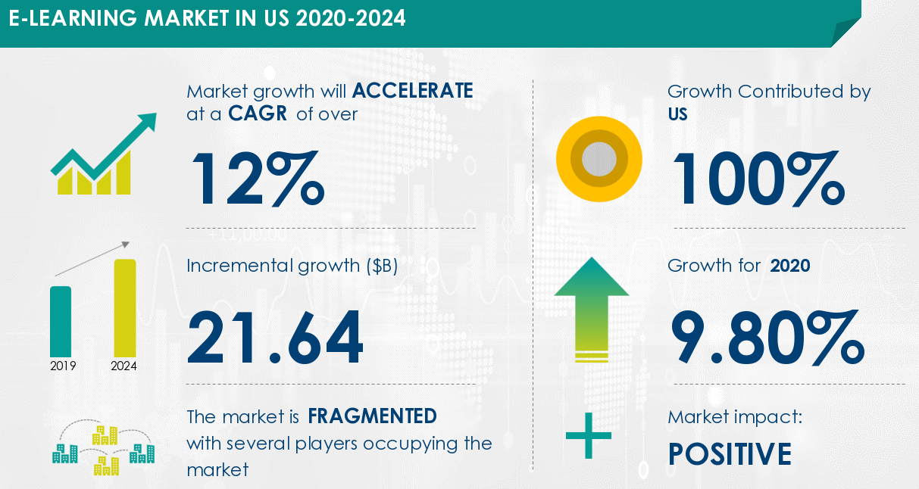
Digital Learning Market Trends
Figure 1
From “E-Learning Market in the US to Grow by $ 21.64 Billion During 2020-2024 | Evolved Learning and Education Landscape to Boost Growth | Technavio,” by Business Wire, n.d. Copyright 2022 by Business Wire.
Notes:
With the continuing rapid growth of the internet and digital content in general, digital learning opportunities are expanding exponentially every year. LearnPlatform’s own database currently has more than ten thousand registered digital learning products.
Some researchers estimate that the e-learning market will have an accelerated CAGR, or compound annual growth rate, of over 12% between 2020 and 2024. Growth in 2020 alone was 9.8%.

Slide 4

Project Background & Goals
49.4 M K-12 school age children
COVID-19 effects
Rapid growth of digital learning opportunities (93%)
Widening gaps in access
Work toward all children having sufficient access to digital education resources
(NCES, n.d.; US Census Bureau, 2020)
Notes:
According to the National Center for Education Statistics, there are almost 50 million school-aged children in the US.
With the advent of the COVID-19 pandemic, we were faced with a national crisis in terms of learning, in large part due to school closures and a much different learning environment in general. According to a 2020 US Census Bureau report, 93% of survey respondents who reported having school-aged children in their household, also reported that those children relied on some form of distance learning.
We also saw in 2020 a trend where those traditionally left behind in terms of access to digital learning, either because of income or socio-economic characteristics that placed them in a marginalized group, were at risk of falling further behind as digital learning necessarily became the norm.
The flipside of the pandemic, however, is that we are also presented with an unprecedented opportunity to strengthen digital learning for the future, as well as work towards closing disparity gaps for children who have challenges with access and engagement.

Slide 5
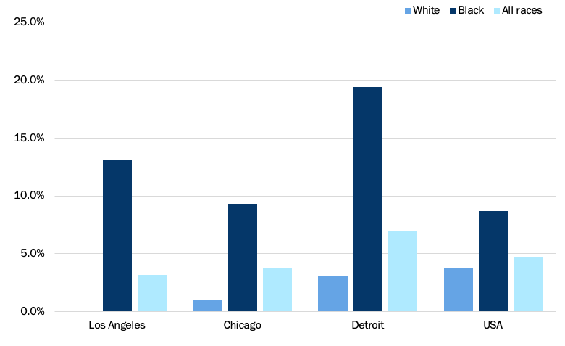
Disparities in Access
Figure 2
Device is rarely or never available for learning, by race for three selected metro areas and US
Source: US Census Bureau Household Pulse Survey
From “Unequally Disconnected: Access to Online Learning in the US,” by V. Collis and E. Vegas, 2020, Education Plus Development. Copyright 2022 by The Brookings Institution.
Notes:
As one example of the many possible impediments to access of the internet and digital learning platforms, this graph from Collis and Vegas at The Brookings Institution shows significant disparities in availability of devices for learning use across white and Black people in three US cites, as well as the overall country. The differences are highly significant across the board and highlight a major challenge some children and their families must deal with in terms of digital learning.

Slide 6

Business Questions Identified
Current state of online engagement? Are there influencing factors?
Pandemic effects on engagement? Some groups impacted more?
Can certain measures improve online engagement for groups facing access challenges? For all students?
Notes:
The project team have identified several important questions to address:
Can online engagement be sufficiently described? Moreover, what factors, such as demographical makeup of districts, access to reliable internet, or government policy decisions and legislation, have a measurable effect on outcomes?
What are the full effects of the COVID-19 pandemic on digital learning outcomes, such as engagement? Were groups already at a digital disadvantage impacted more? By how much?
Lastly, how have policy actions enacted since the start of the pandemic affected digital learning? Have state-wide mandates helped with access and engagement rates?

Slide 7


Business Objectives
Objective 1: Describe
Summarize and visualize data to gain insights
Objective 2: Predict
Which student populations face gaps in access
Which public policy actions positively affect access and engagement
Notes:
Though the Data Science Team will be using state-of-art data science and machine learning techniques, the aims of this project can be broken down into two main business-focused objectives:
First, use the data to describe the state of post-pandemic digital learning to gain insights and understand trends in access and engagement, especially relative to differences between groups differentiated by such things as level of spending per pupil in a district, locale, race/ethnicity, whether meals were subsidized, etc.
Secondly, use the data and insights to make predictions about: one, which districts are in danger of having students fall behind in terms of access and engagement; and two, whether any enacted state or local mandates related to stopping the spread of COVID-19 had a positive impact by narrowing or reversing gaps in access.

Slide 8
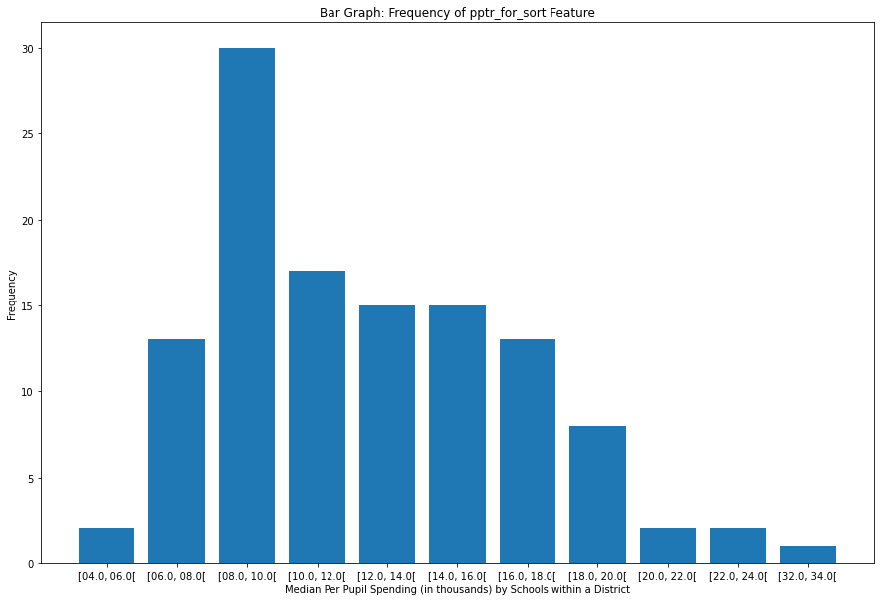
LearnPlatform Data Visualizations
Figure 3
Notes:
The graphs on this slide and the following were generated based on LearnPlatform’s current data as examples of visualizations that can used to help gain business insight.
Figure 3 shows the frequency of median per pupil spending within each of the available ranges. A lot of spending is occurring in the eight to ten thousand dollar per pupil range. In fact, the average is roughly between 7700 and $9000 per student.

Slide 9
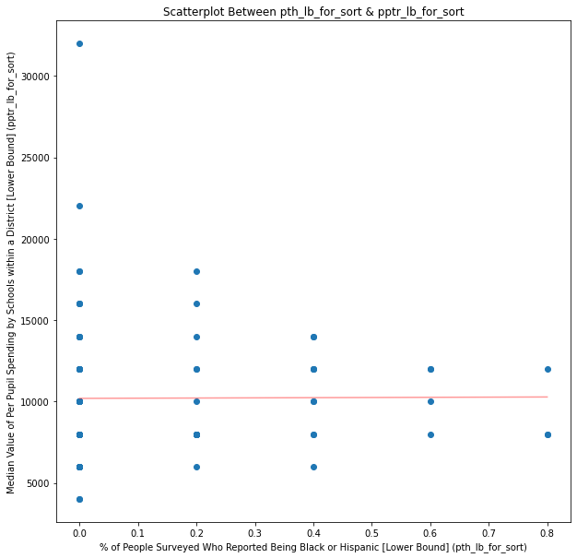
LearnPlatform Data Visualizations
Figure 4
Notes:
Figure 4 is comparing the percentage of people reporting as Black or Hispanic on the horizontal axis, to the spending per pupil on the vertical axis. The red trend line indicates a very flat relationship between the variables, but it can generally be seen that as the percentage of Black and Hispanic people increases, the points on each side of the line squish further together, indicating that districts with higher percentages of People who are Black or Hispanic get more consistent amounts across the district, but none of those districts receive large amounts per pupil. This raises the question of why in the districts with very low percentages of Black and Hispanic people there are a number of schools with very low per pupil spending; the underlying relationships of these features and implications would be examined further as the project continues.

Slide 10

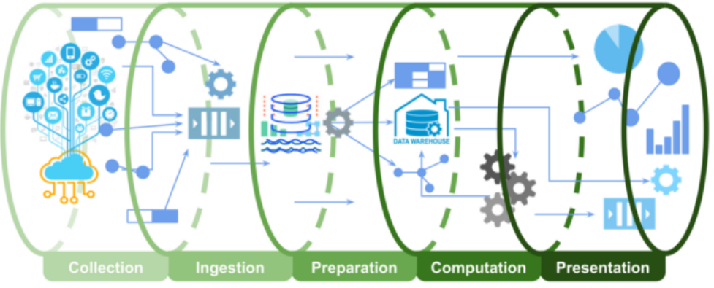
Constraints, Assumptions, Considerations
Short timeline
Data is accessible, sufficient to make predictions
Figure 5
From “Architecture for High-Throughput Low-Latency Big Data Pipeline on Cloud,” by S. C. Gupta, 2020, Towards Data Science. Copyright 2022 by Medium.
Notes:
There are several constraints and assumptions that must be made as part of answering the business questions. These include the requirement of a somewhat aggressive timeline of 15 weeks to move from project planning to the Engineering production phase.
We must also be sure the data is of sufficient amount and makeup that an efficient pipeline from gathering to visualizing and reporting can be instituted, and that the resulting models will perform well and accurately represent the overall populations.

Slide 11

Constraints, Assumptions, Considerations (Cont’d)
Value-add to 3 core customer bases
Summary stats provide insights
Predictive models prove consistently reliable
Notes:
Additionally, we need to make sure that new information is easily digestible by education organizations, state education agencies, and edtech product providers. If they are not able to use it to make informed decisions or provide evidence-based information to their own stakeholders, it won’t provide sufficient value-add and thus will restrict return on investment.

Slide 12
Constraints, Assumptions, Considerations (Cont’d)
Focus on ethically aligned design (EAD)
Biases can be identified and addressed
High emphasis on ethical considerations
Meaningfulness, accountability, responsibility, transparency
(Vakkuri & Kemell 2019)
Notes:
Lastly, it is fundamentally critical to focus on ethics and transparency as key components of the project. We must do all we can to ensure all biases, such as those resulting from what or how data was collected, can be determined and addressed.
We must also constantly examine and reframe our own ethical considerations, as part of both model creation and evaluation. Carr-squared uses a well-established and documented ethically aligned design framework called RESOLVEDD.

Slide 13

Project Solutions & Advantages
Seamless service expansion to existing edtech effectiveness system (EES)
Descriptive details of the data
Predictive modeling to enable “leaps” in understanding
Notes:
So, what are the proposed solutions?
Two sets of data science models will be developed to be seamlessly added to the existing customer dashboard.
Education organizations and edtech product providers will have access to visualizations and summary tables of information. They will be updated whenever new data is available and will provide evidence for where to target efforts to strengthen engagement at a more local level.
On the state-wide level, officials and law-makers will be able to review information that provides evidence as to where limited resources need to be allocated, or legislation needs to be proposed.

Slide 14
Return on Investment (ROI) Opportunities
Increasing digital learning in public sphere
More value-add services that will:
Strengthen current customer relationships
Potentially increase customer base
Notes:
Obviously, return on investment is an essential consideration in developing new services. Aside from leveraging existing LearnPlaform staff knowledge and expertise to see this project through, which will help keep costs to a minimum, the success of this project will provide evidence to state officials as to the overall value of digital learning, as well as further illustrate LearnPlatform’s commitment to providing an integral and comprehensive social service. This then will strengthen existing relationships and ideally bring in additional customers.

Slide 15

Next Steps
Continue Processing Data
Build & Evaluate Models
Develop & Deploy
Transfer Model Frameworks to Engineers
Notes:
The next steps once approval to continue the project is received is to carry on with processing the data to get the most useful dataset for building, fine-tuning, and evaluating the analytics models. Evaluation will focus on model performance as well as how well the ethical framework is being implemented within design.
The Data Science Team will also meet with Programming Team staff to determine a development plan, which includes interim steps based on Agile methodologies, as well as project end-state frameworks needed to transfer code from data science production to Engineering development phases.

Slide 16

Conclusion
Expected benefits:
Early implementation of analytics functionalities to existing EES
Predictive models address digital learning access and engagement issues
Reduction of online engagement gaps
Strengthening relationships with customers
Notes:
Making the decision to move this project forward will facilitate several benefits for LearnPlatform and your customers.
This includes early deployment of a critically needed service. Because services would attach to an existing dashboard, the timeline to deployment is reduced.
Another crucial benefits is the use of specific predictive models focused on issues fundamental to increasing digital learning access and engagement, which potentially allows not just for descriptive summaries of information, but prescriptive action.
There would also be a potential reduction of online engagement gaps among geographically and socio-economically diverse student populations, thereby increasing access and engagement for all students.
Lastly, relationships with customers will be reinforced.

Slide 17
References
Business Wire. (n.d.). E-learning market in the US to grow by $ 21.64 billion during 2020-2024 | Evolved learning and education landscape to boost growth | Technavio. https://www.businesswire.com/news/home/20210204006191/en/E-Learning-Market-in-the-US-to-Grow-by-21.64-Billion-During-2020-2024-Evolved-Learning-and-Education-Landscape-to-Boost-Growth-Technavio
Census Bureau (2020, August 26). Schooling during the COVID-19 pandemic. U.S. Department of Commerce. https://www.census.gov/library/stories/2020/08/schooling-during-the-covid-19-pandemic.html
Collis, V., & Vegas, E. (2020, June 22). Unequally disconnected: Access to online learning in the US. Education Plus Development. https://www.brookings.edu/blog/education-plus-development/2020/06/22/unequally-disconnected-access-to-online-learning-in-the-us/
Gupta, S. C. (2020, March 3). Architecture for high-throughput low-latency big data pipeline on cloud. Towards Data Science. https://towardsdatascience.com/scalable-efficient-big-data-analytics-machine-learning-pipeline-architecture-on-cloud-4d59efc092b5
NCES. (n.d.). Back-to-school statistics. US Department of Education and the Institute of Education Sciences, National Center for Education Statistics. https://nces.ed.gov/fastfacts/display.asp?id=372
Vakkuri, V., & Kemell, K.‐K. (2019). Implementing AI ethics in practice: An empirical evaluation of the RESOLVEDD strategy. In S. Hyrynsalmi, M. Suoranta, A. Nguyen‐Duc, P. Tyrväinen, & P. Abrahamsson (Eds.), Software Business (Vol. 370, pp. 260–275). Springer International Publishing.
Notes:
I utilized the following sources to put together this presentation.

Slide 18

Thank you!
CarR² Contact info: Aaron Carr, acarr@sandiego.edu
Notes:
Thank you so much for your time, and I look forward to continuing our work on this innovative, timely, and important project. If you should have any questions, please feel free to reach out to me anytime.

